Slide 1
Frequency Shift Keying
Presented by Saptarshi Mondal
Roll No. – 168000117024
3rd Year CSE

Slide 2
Content
Introduction to FSK
Types of FSK
FSK Modulator
FSK Demodulator
Application of FSK
Advantages & Disadvantages of FSK
Conclusion

Slide 3
Introduction to Frequency Shift Keying
Frequency Shift Keying (FSK) is the digital modulation technique in which the frequency of the carrier signal varies according to the digital signal changes. FSK is a scheme of frequency modulation.
The output of a FSK modulated wave is high in frequency for a binary High input and is low in frequency for a binary Low input. The binary 1s and 0s are called Mark and Space frequencies.

Slide 4
Types Of Frequency Shift Keying(FSK)
Continuous-phase frequency-shift keying
Gaussian frequency-shift keying
Minimum-shift keying
Gaussian minimum-shift keying
Audio FSK

Slide 5
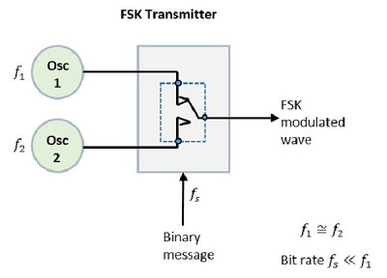
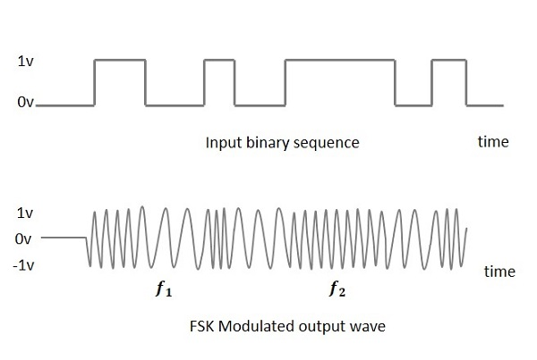
FSK Modulator
The FSK modulator block diagram comprises of two oscillators with a clock and the input binary sequence. Following is its block diagram.
The two oscillators, producing a higher and a lower frequency
signals, are connected to a switch along with an internal clock.
To avoid the abrupt phase discontinuities of the output
waveform during the transmission of the message, a clock is
applied to both the oscillators, internally. The binary input
sequence is applied to the transmitter so as to choose the
frequencies according to the binary input.

Slide 6
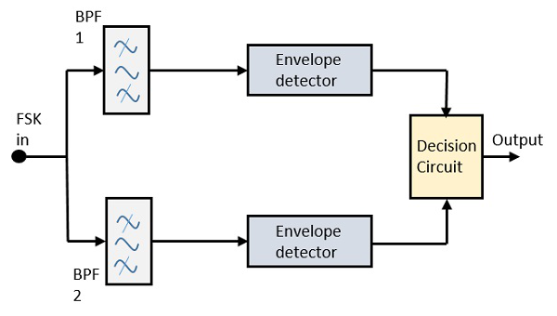
FSK Demodulator
There are different methods for demodulating a FSK wave. The main methods of FSK detection are Asynchronous detector and Synchronous detector. The synchronous detector is a coherent one, while asynchronous detector is a non-coherent one.
Asynchronous FSK Detector
The block diagram of Asynchronous FSK detector consists of two band pass filters, two envelope detectors, and a decision circuit. Following is the diagrammatic representation.
The FSK signal is passed through the two Band Pass Filters BPFs, tuned Space and Mark frequencies. The output from these two
BPFs look like ASK signal, which is given to the envelope detector.

Slide 7
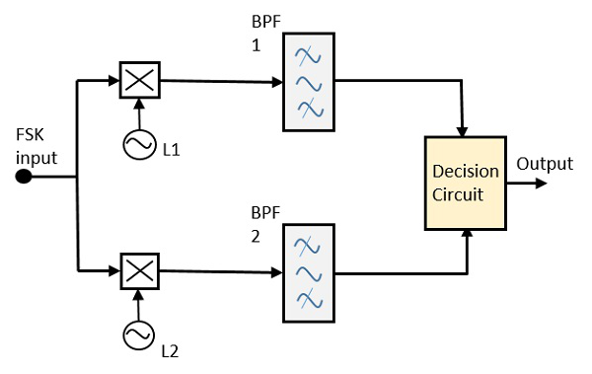
The signal in each envelope detector is modulated asynchronously.
The decision circuit chooses which output is more likely and selects
it from any one of the envelope detectors. It also re-shapes the
waveform to a rectangular one.
Synchronous FSK Detector
The block diagram of Synchronous FSK detector consists of two mixers with local oscillator circuits, two band pass filters and a decision circuit. Following is the diagrammatic representation.
The FSK signal input is given to the two mixers with local oscillator circuits. These two are connected to two band pass filters. These combinations act as demodulators and the decision circuit chooses which output is more likely and selects it from any one of the detectors. The two signals have a minimum frequency separation.
For both of the demodulators, the bandwidth of each of them depends on their bit rate. This synchronous demodulator is a bit complex than asynchronous type demodulators.

Slide 8
Applications of FSK
Caller ID on Telephone System
Amateur Radio
Early Telephone-Line Modems
Emergency Broadcast Systems
Modems

Slide 9
Advantages & Disadvantages
Advantages
It has lower probability of error(Pe).
It provides high SNR(Signal to Noise ratio).
It has higher immunity to noise due to constant envelop.
FSK transmitter and FSK receiver implementations are simple
for low data rate application.
Disadvantages
It uses larger bandwidth compare to other modulation
techniques such as ASK and PSK. Hence it is not
bandwidth efficient

Slide 10
Conclusion
FSK signals take many different forms depending on their intended application. With the increasing sophistication of electronics and signal detection theory, it is clear that FSK demodulators, are required to optimally demodulate the many different signal formats
A comparison of the FSK spectrum with the spectrum over which an FM-type FSK detector is sensitive to interference leads to the conclusion that the performance of an FM-type FSK detector is severely limited by its relatively wide input bandwidth.

Slide 11
Thank You!!

